Slide 1
Predictive Modelling For Cab Rides
Karan Bari
Ravi Munde

Slide 2
Introduction
Boston has on of the highest cab ride frequency in the country^{[1]}
Cab prices vary depending on various conditions like weather and time
Our aim was to build a framework to analyse this price fluctuation and predict the price given the set of features

Slide 3
Phases
Phase 1: Data Collection
Phase 2: Data Exploration
Phase 3: Modelling & Evaluation

Slide 4
Phase 1: Data Collection
Libraries used:
Uber API
Official Java SDK used in Scala
Lyft API
Official Android SDK used in Scala
Weather API(Darksky)
scala-weather library from Snowplow
DyanmoDB
Scanamo library

Slide 5




Use Cases
Uber Data Query
Lyft Data Query
Weather Data Query
Push Data to DynamoDB

Slide 6

Actors
Internal System Pipe
External System
Cab Price Actor
Master
DynamoDB Actor
Weather Actor
Notes:
Async System
No call is evaluated and piped to next actor when future is completed

Slide 7
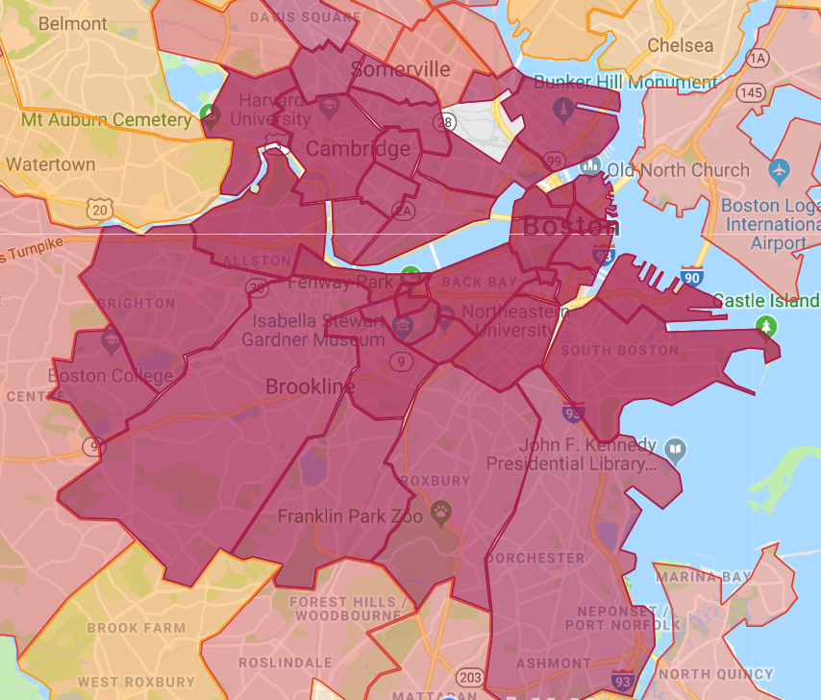
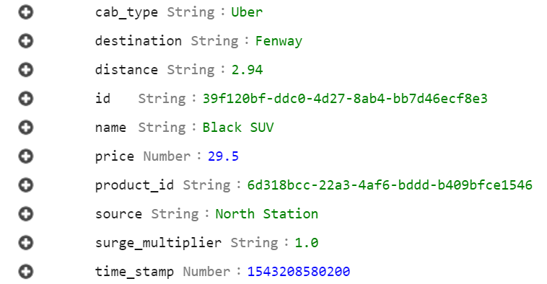
Cab Data
We selected 12 busiest neighbourhoods to get prices
Random pairing of source and destination; to & from
Both the Lyft and Uber APIs are queried every 5 minutes
Each call results in 156 CabPrice records
Uber rides heat map

Slide 8
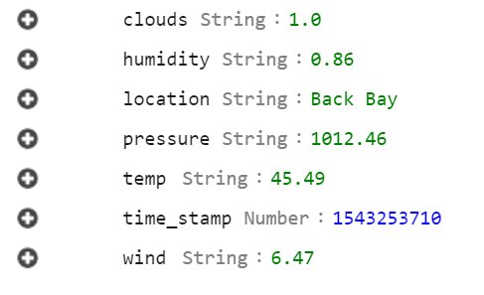
Weather Data
Get current weather for all 12 locations
DarkSky API queried every hour
Each call results in 12 Weather records

Slide 9
Key Highlights
Project build using Maven
Logging with SL4J
Akka actor with pipes for non-blocking calls
Build deployed on AWS EC2 as a service

Slide 10
Phase 2 : Data Exploration
Total Cab Price records collected : 400k
Total Weather records collected : 4.5k
Identified key features impacting cab prices

Slide 11
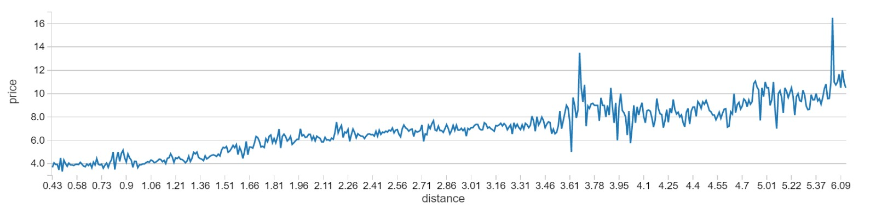
Price vs Distance
Plotting strong linear relationship between prices and distance.

Slide 12
Surge Multiplier per day

Slide 13
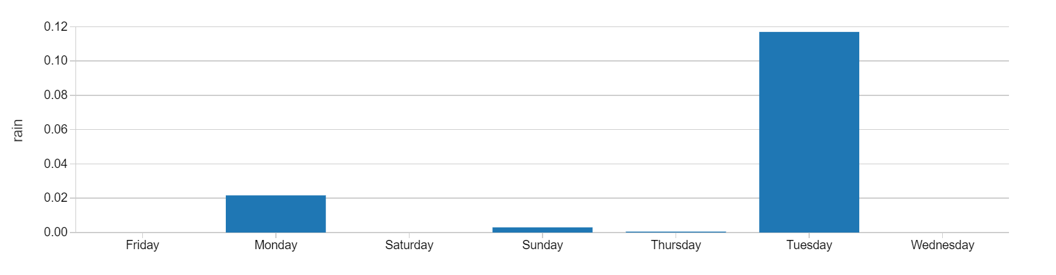
Average rainfall throughout the week
As seen from the analysis Surge prices were observed highest on Tuesdays, and we can conclude from the below graph that Tuesday observed highest rainfall throughout the week.

Slide 14
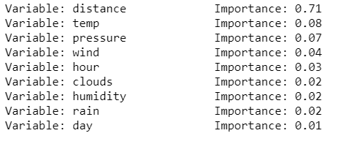
Phase 3: Model and Evaluation
For Regression, we selected Distance, rain, hour_of_the_day, Location, Day_of_the_week, temp.
By using these features we achieved R squared of 0.62 and RMSE 1.13
By using Random Forest Regressor we achieved 92.79% (targeted 75%) accuracy
Feature Importance

Slide 15
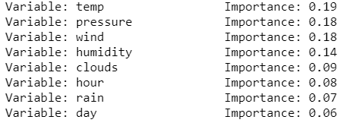
Predicting Surge Multipliers
Using Random Forest classifier, predicted the surge multiplier with accuracy of 77%.
Precision: 98%
Recall: 77%

Slide 16
What was changed from proposal
We realised that Spark Doesn’t have out-of-the-box DynamoDB stream support
We then built our own Stream Adapter for DynamoDB https://github.com/ravi72munde/spark-dynamo-stream-asl
However, the models built using this spark streaming was updated real-time and didn’t account for daily variance.
We found that an offline model gave better accuracy.
Since Databricks went down for few days, we build two models on python which actually gave better accuracy.

Slide 17
Thank you

